Slide 1

2025 ASEAN IPA
Session 1:
Cross-Border IP Issues on Enforcement in the Digital Space
Ben Yuu
President, APAA Korea Group
Managing Partner, NAM IP Group
Ben Yuu
byuu@nampat.co.kr

Slide 2
Topics:
Cross Border Activity
Computer Program Inventions
Production in Foreign Country
Enforcement of Foreign Judgments

Slide 3


1.
Cross Border Activity
SK Telecom v. Viber
Seoul District Court (2013Gahap546931, Feb 17, 2015)
Seoul High Court (2015Na2014387, Oct 8, 2015)

Slide 4

“Viber integrates with your phone’s contacts to automatically add to your viber contacts.”
(https://www.tech-recipes.com/apps/how-to-add-contacts-on-viber/)
KR Patent (10-0681926)
A method for automatically organizing the phone's address book for use in an instant messenger.
(The phone already has an existing contact list.)
A new format is created for the messenger’s contact list.
The system extracts only the required contact details.
The extracted data is processed and saved for the messenger.

Slide 5
Issue 1. Who directly performs the patented method?
[Viber’s argument]
Viber merely develops and provides the app.
Viber does not carry out all of the steps of the invention by itself
Users carry out some of the steps of the invention
[Court’s view]
Users merely approves the app to execute the method.
Once approved, each step of the process is carried out through the interaction between the Viber app and the server over a network.
Viber deliberately omitted some of these steps of the method and caused users, who were unaware of such intent, to carry out them.
Viber effectively executed all elements of the invention by utilizing smartphone users as tools.

Slide 6
Issue 2. Is the infringement occurred in Korea?
[Viber’s argument]
Both the development and transmission of the app take place overseas.
Server(http://www.viber.com) is located in other country (Cyprus).
[Court’s view]
The app is ultimately installed and used within the territory of Korea.
The act of the address book reorganization takes place on the mobile devices in Korea.
Court Order:
The Defendant shall not distribute the "Viber App" within Korea.
The Defendant shall take measures to prevent the distribution and use of the Viber Application within Korea via the server.

Slide 7
2.
Computer Program Inventions
Computer Programs in Korea:
Not a patentable subject matter by itself
Not considered a "product" or "apparatus" under patent law
"Computer programs stored on a medium" is allowable.
A method claim is allowable.
Law change (Dec 2019)
§2(3) "Working“ of patent refers to the following acts:
b) In the case of a method claim: Using the method or making an offer to use the method. (since 2019.12)
* only when knowing that such use would infringe the patent right (§94②)
Applicable when the program is distributed online
Similar to Infringement by Inducement (?)

Slide 8
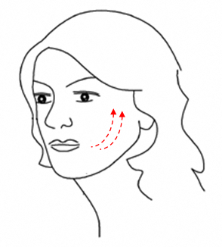
3.
Production in Foreign Country
(Face Thread Lifting)
KR Patent No. 10-1326763
Title: Medical Thread Insertion Kits
Filing Date: 2012년09월24일
[Fig.8]

Slide 9


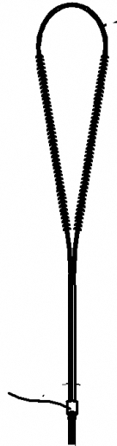
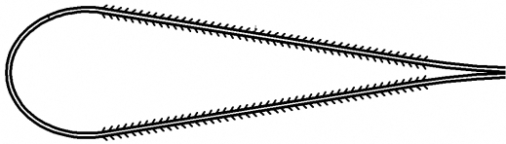
Claim 6 = ①+②+③+④
① Catheter
② Hub
③ Thread
④ Cone
⑤ Push bar
①
②
③
④
⑤

Slide 10
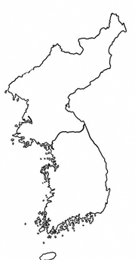
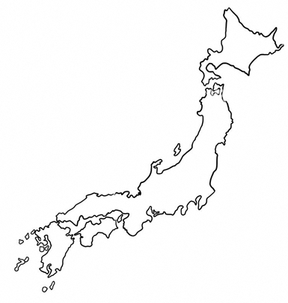
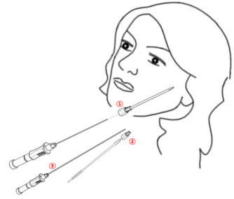

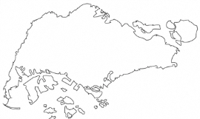
⑤
①
Korea
Japan
Hospital
export
②
③
Claim 6 = ①+②+③+④
④
Singapore

Slide 11
[Supreme Court]
Definition of “Production" in Patent Act
Any act of creating a complete product by
  Industrial manufacturing, or
  Assembly of components.
An Exception to the Territoriality Principle of Patent Rights
Production in foreign country may still be considered domestic working of the patent if:
All essential components are manufactured domestically.
It is prearranged that they will be exported to a single entity, where they will undergo the final-stage processing or assembly.
Such final processing is so trivial or simple that the production of the parts has already reached a state that embodies the functional effects of the patented invention as a whole.

Slide 12
Conspired to export the components.
Defendant B
Exported components
Delivered ②,③,④
Defendant A
Claim 6 = ①+②+③+④
Order
Delivered ①
(no substantial non-infringing use)
Defendant C
Defendant A: Sole Patent Infringement
Defendants A & B: Joint Patent Infringement
Defendant C: Indirect Infringement
➔

Slide 13
4.
Enforcement of Foreign Judgments
A system that allows enforcement of foreign judgments in Korea
Damage awards can be enforced
Injunction orders (such as sales bans) cannot be enforced.
Dismissal Rate: Approximately 22%
  U.S. court judgments: 35% dismissal rate
  Japanese court judgments: 0% dismissal rate
  (same civil law system as Korea/Germany)

Slide 14
Approval Requirements
A final judgment of a foreign court shall be recognized if:
  The jurisdiction of the foreign court is recognized according to Korean law or treaties.
  The defendant is properly served (not including service by public notice).
  The content and procedure of the foreign judgment is not violate public order or good morals in Korea.
  There is reciprocity, meaning that the foreign country's recognition standards are not substantially different or significantly imbalanced compared to Korea’s.
  (§ 217 of the Civil Procedure Act)

Slide 15
Principle of prohibition of substantive review
“An enforcement judgment shall not examine the merits of the foreign judgment.”
(§27① of the Civil Execution Act)
* In practice, courts often examine the substantive merits of a judgment when determining whether it violates public order.

Slide 16
Case Overview
Plaintiff: Japanese chemical manufacturer (NAM IP’s client)
Defendant: Korean chemical company)
Foreign Judgment:
  US court (Northern District of Texas, Dallas Division (2013)
  Total damages awarded: USD 6,508,208
    Compensatory damages: USD 5,500,000
    Royalty-based damages: USD 345,000
    Interest: USD 663,208
  Induced infringement was also recognized.
Korean enforcement lawsuit:
    Filed in 4/4/2018
    Jeonju District Court

Slide 17
Case progress
April 4, 2018:
  Filed an enforcement lawsuit for the foreign judgment.
  Requested preliminary injunction (asset seizure of B’s factory and land) to secure the damage claim.
  Injunction registration fee: KRW 16,494,390.
April 6, 2018:
  Court ordered security deposit of KRW 690,000,000 (approx. 10% of the claim amount).
  Replaced deposit with surety bond (insurance premium: KRW 1,041,900).
April 13, 2018:
  Injunction granted.
May 28, 2018:
  Requested litigation security deposit for enforcement case.
June 19, 2018: Litigation security deposit posted.
September 19, 2018: First court hearing.
November 14, 2018: Second court hearing. Judge suggested settlement.
January 17, 2019: Negotiations between plaintiff and defendant.
February 12, 2019: Submitted opinion on settlement recommendation.
February 14, 2019: Final settlement reached:
  Defendant agreed to pay USD 9,500,000.
  Plaintiff withdrew lawsuits related to two patents.

Slide 18
Thank you!
감사합니다
Ben Yuu
byuu@nampat.co.kr

